Slide 1


Slide 2

Remember analytical studies as types of observational epidemiological studies
They are very popular for investigating associations
Why are associations important
  To identify risk factors for disease
  When the risk factors are known we can take measures to prevent their use
What are examples of those risk factors?

Slide 3

Salt intake and Hypertension
Early sexual initiation and cervical cancer
Oral contraceptive use and breast cancer
Alcohol use and chronic liver disease
Analytic epidemiology investigates the association between these risk factor disease pairs

Slide 4

An observational study
Analytical : there’s a comparison group
Subject selection based on disease status or health event status
Groups compared concerning proportion with exposure

Slide 5

Used with respect to timing of the relevant events (exposure and disease) and initiation of the study
Retrospective case control
  All cases are diagnosed at time investigator initiates study
Prospective case control
  All new cases diagnosed within the next few years after study is initiated are included in the study

Slide 6

Population within which study is conducted is a fully enumerated cohort which allows formal sampling of cases and controls to be carried out
Case control study conducted within a cohort
Further information (perhaps from expensive tests obtained from all cases but from a fraction of remaining cohort members (controls)

Slide 7

Has been be used in studies relating risk factors measured in blood to incidence of disease
When a sufficient number of cases of a disease of interest accrue, controls are selected from unaffected cohort members who are still alive and under surveillance at the time the cases developed the disease
Availability of variety of banks of stored sera and the current interest in serological predictors of disease make this design popular

Slide 8

Case control study within a retrospective or prospective cohort study
Example is a cohort study designed for a large sample (thousands) where blood samples are taken at the start of study and frozen and stored
Blood samples are taken to test for presence of an exposure
The number who develop a disease is of interest

Slide 9

After years of follow up, new cases of the disease are identified
These new cases serve as the cases for the nested case control study
A random sample of those who have not developed the disease (maybe less than 500) is taken and serves as controls for the nested case control study

Slide 10

Comparability of comparison groups (case and control) is essential
How study groups are selected
Sources of information about exposure and disease

Slide 11

Disease should be homogenous and specific
Definition of disease
Clear and strict diagnostic criteria
Selection
  Hospital based(more common, convenient)
  Population based(avoids bias from hospital sample; enables computation of rates;expensive)

Slide 12

Incident or prevalent cases
Prevalent cases increase sample size (but at a cost)
Whenever possible cases should be limited to incident cases

Slide 13
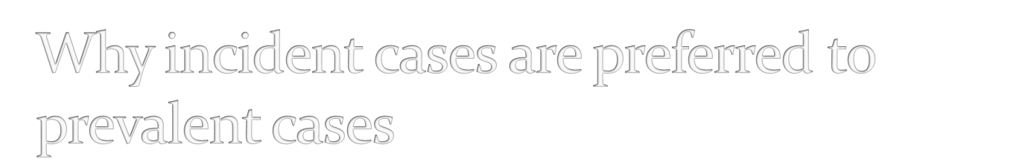
If a case has had disease for a long time it may be difficult to remember exposures (temporality concerns)
Leads to overrepresentation of cases of long duration because those who die or are rapidly cured have low chance of being included
  Presence of disease may have influenced their exposure to possible risk factors e.g. lifestyle modification following diabetes or cancer symptoms

Slide 14

Issue of temporality (ascertaining that exposure precedes disease)
  For many diseases the actual time of onset is unknown or ill-defined
  Important to ensure exposure at least preceded onset of symptoms
  In diseases with slow onsets e.g. multiple sclerosis it may be necessary to find out when symptoms began

Slide 15
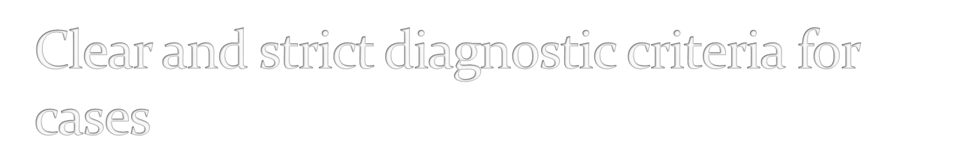
Diagnostic criteria based on information from
  routine medical record (pathology, radiology etc)
  Interviews
  Clinical examination

Slide 16

From population based disease registers such as cancer registry
Incident cases seen at hospitals
Patients seeking care from private hospitals
Patients at places of employment, military service etc

Slide 17

The control series is intended to provide an estimate of the exposure rate that would be expected to occur in the cases if there were non association between the study disease and exposure’ (Schlesselman (1982))
The controls should be selected in an unbiased manner from those individuals who would have been included in the case series, had they developed the disease under study (Miettinen 1985)

Slide 18

No control group is optimal for all situations
Selection of control group should be suited to the types of cases(characteristics and source)
Controls should be comparable to the source population of cases
Restrictions applied in selection of cases should be used in controls’ selection
Economic and practical considerations

Slide 19

Hospital controls
General population controls
Special controls: friends, neighbours, relatives etc

Slide 20

For hospital based cases, controls usually patients at same hospitals admitted for other conditions
Advantages of hospital controls
  Easily identified, sufficient sample
  More likely to be aware of past exposures/events
  Being hospital patients makes them similar to cases concerning utilization of hospital services
  More likely to cooperate with research
Disadvantage
  Differ from healthy individuals
  Controls who have diseases related to exposure may underestimate risk

Slide 21

Assures greatest level of comparability
Methods of selection
  Canvassing households
  Identification from population registers
Usually costly
Population lists difficult to get or unavailable
May not recall exposures with same accuracy
Healthy subjects less motivated to participate in study

Slide 22

Healthy and more likely to cooperate compared to general population controls
Quite similar to cases
For lifestyle risk factors they may underestimate the true effect of the exposure

Slide 23

Information on disease status can be gotten from
  Review of death certificates
  Case registries
  Physician’s records
  Hospital records
  Pathology records

Slide 24

From study participants
Interview
Mail questionnaire(postal or electronic)
Spouses, mothers of children
Medical records

Slide 25

Frequency of exposure compared between cases and controls
Impossible to estimate incidence (true risk)
Odds ratio, an estimate of the relative risk is computed
Possible however to estimate incidence in population based case control studies

Slide 26

Chance
Bias
Confounding

Slide 27

Before conclusions can be drawn fro any epidemiologic study investigating association (whether case control, cohort, correlational or experimental), the role of chance, bias and confounding must have been investigated

Slide 28

In evaluating the role of chance we are trying to answer the question: What is the chance that the observed association arose by chance factors or sampling variability alone?
  Is the p value less than 0.05?
  Does the confidence interval cross 1?
In evaluating the role of bias we trying to verify whether selection bias, misclassification bias, outcome bias or any other bias type is an alternative explanation for our observed association

Slide 29
In evaluating the role of confounding we are trying to ensure that the observed association cannot be explained by another variable (a third variable) due to its relationship with both the exposure and the disease
  This can be done by studying individuals that are at only one level of the third variable (NOT VERY GOOD APPROACH)
  OR adjusting for the third variable using statistical methods

Slide 30

When the three (chance, bias and confounding) have been accounted for then our conclusions will be more valid
However this doesn’t mean a causal relationship, there are more criteria to confirm causality.

Slide 31

Odds ratio is the measure of association between exposure and disease for case control studies
It estimates the relative risk, the ratio of incidence of disease in exposed to incidence of disease in unexposed
Odds ratio is the ratio of odds of exposure among cases to odds of exposure among controls

Slide 32

Interpretation of odds ratio
  1 when the odds of exposure among cases is same as odds of exposure among controls i.e. there is no association between exposure and disease(Null association)
  <1 when there is a negative association between exposure and disease i.e. exposure is protective
  >1 when there is positive association between exposure and disease i.e. exposure is a risk factor for the disease

Slide 33

 |  | Cases | Controls
Exposure | Yes | a | b | a+b
 | No | c | d | c+d
 | Total | a + c | b + d | a+b+c+d

Slide 34
Odds of exposure among cases = a/c
Odds of exposure among controls = b/d
Odd ratio (OR) = ratio of odds of exposure among cases to odds of exposure among controls
OR = a/c = ad/bc (Cross product ratio)
b/d

Slide 35

The role of condom use in the prevention of HIV was investigated using a case control design. 150 HIV positive individuals and 1500 HIV negative controls were asked about consistent condom use. Thirty of the HIV positive subjects compared to 576 of controls reported consistent condom use.

Slide 36

 |  | HIV Status
 |  | HIV positive Cases | HIV Negative Controls
Consistent condom use | Yes | 30 | 576
 | No | 120 | 924
 | Total | 150 | 1500

Slide 37

Odds ratio = ad/bc
= 30 x 924 = 0.40
576 x 120

Slide 38

There’s a negative association between condom use and HIV status
Condom use is protective of HIV

Slide 39


Relatively quick
Inexpensive
Suitable for diseases with long latent periods
Used for evaluating rare diseases
Examines multiple exposures

Slide 40

Inefficient for rare exposures
Incidence cannot be directly determined
Temporality a concern for exposure and disease
Prone to selection and recall bias

Slide 41

(1) Findings from a case control study of 2866 breast cancer cases and 3141 controls derived from a nationwide screening program are shown in Table below. Determine
a. The odds ratio relating menopausal status to breast cancer and interpret your result
b. The confidence interval for this odds ratio and interpret your result

Slide 42
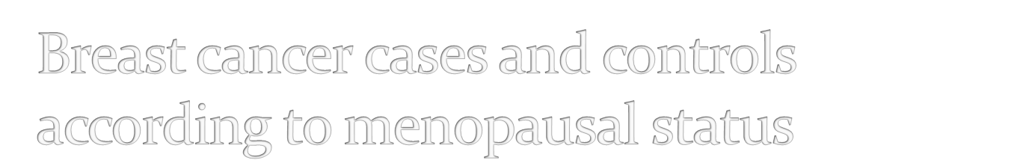
 |  | Breast cancer
 |  | Cases | Controls
Menopausal status | Premenopausal | 887 | 868
 | Postmenopausal | 1979 | 2273
 | Total | 2866 | 3141

Slide 43
(2) The sample was divided into 2: women with history of contraceptive use and those without. Among contraceptive users there were 247 premenopausal women out of 1132 cases and 197 premenopausal out of 2046 controls.
See questions on the next slide

Slide 44
Calculate odds ratios of the association between menopausal status and breast cancer and 95% confidence intervals for the two samples.

Slide 45

Kesley J L, Whittemore A S, Evans A S & Thompson W D (1996) Methods in Observational Epidemiology Oxford University Press, New York
Hennekens, Buring Epidemiology in Medicine
Rothman K J, Greenland S, Lash T L. (2008) Modern Epidemiology 3rd ed Lippincourt Willas and Wilkins Philadelphia

Slide 46


